Slide 1

Recommender System Basics
Presented By:
Dibyam Kumar Agrawal
Research Guide:
Bidyut Kumar Patra
Special Thanks to
IDAL Team

Slide 2
Why?
Enhance user experience
Helps to understand the customers better
Increase sale
Saves time

Slide 3
Recommender System
Raw
Data
Processed
Data
Model
Results
Input data
Training
Evaluation
Rating matrix
Item details
User demographic info
Content Based Filtering
Collaborative Filtering
Demographic Filtering
Hybrid Filtering
Prediction Evaluation
Evaluation of set of Rec. Items
Evaluation of ranked Rec. Items

Slide 4
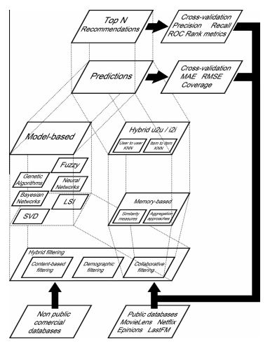

Slide 5
Content Based Filtering
Details
Item details are used to find similarity between items.
DRAWBACKS
Over Specification
Limited Content Analysis

Slide 6
Collaborative Filtering (CF)
Model Based CF
SVD
Bayesian
NN
Fuzzy system
Genetic Algorithm
Latent Feature
Matrix Factorization
Rating Matrix
Select Top N
Memory Based CF
Similarity Metric
Aggregation Method
KNN

Slide 7
Memory Based CF
User Based
Details
Item Based
Details
User based VS Item based
Details
Performance depends on the Dimension of the rating matrix.
Neighbours are fairly static for the chosen one.

Slide 8
Memory Based CF - Similarity Metric
Details
Formulas
Cosine similarity
Correlation similarity
Adjusted Cosine similarity

Slide 9
Memory Based CF – Aggregation Method
Details
Weighted sum
Regression

Slide 10
Model Based CF
Model Based CF
SVD
Bayesian
NN
Fuzzy system
Genetic Algorithm
Latent Feature
Matrix Factorization

Slide 11
Model Based CF - SVD
Details

Slide 12
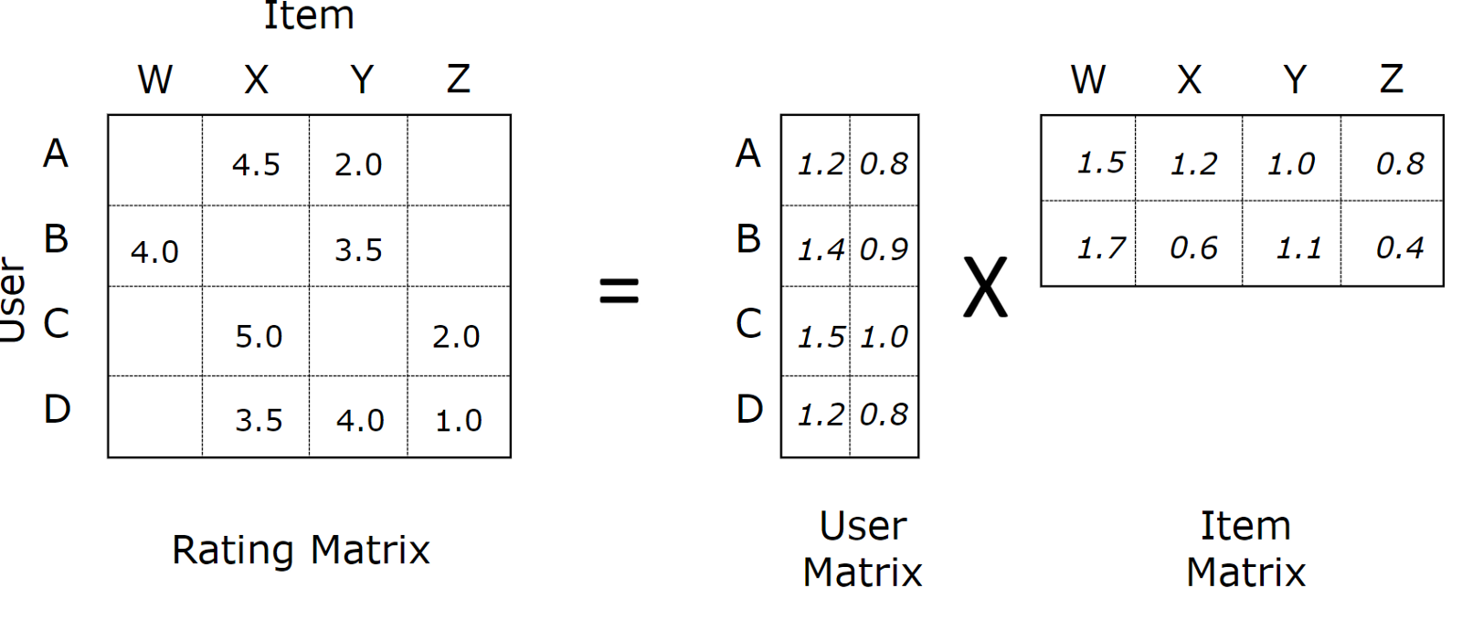


Model Based CF – Matrix Factorization
Predicted Rating-
Using Gradient Descent

Slide 13



Model Based CF – Matrix Factorization
Considering Bias -
Adding Bias to factorization -
Updated Gradient Descent -
Regularization term is Required as the Rating matrix is Sparse, which may lead to over fitting.

Slide 14
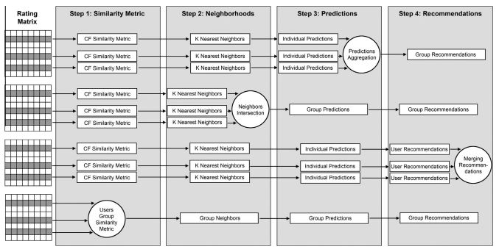
Group Recommendation

Slide 15
Collaborative Filtering
Drawbacks
Cold Start Problem

Slide 16
Demographic Filtering
Details

Slide 17
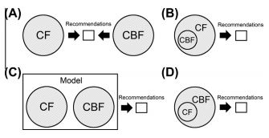
Hybrid Filtering
We try to overcome drawbacks of one using another to generate better Recommendation

Slide 18
Evaluation
Desired Properties
Accuracy
Novelty
Diversity
Stability
Reliability
Prediction Evaluation
Metric - MAE, RMSE, Coverage
Evaluation of set of recommended items
Metric – Precision, Recall, F1
Evaluation of ranked recommended items
Metric – Half life, discounted cumulative gain

Slide 19
Evaluation formulas
ADD PICS

Slide 20
Streaming RS
Details

Slide 21
Topics to cover
TO DO-
Group
Graph
Implicit Feedback
Data Sparsity
Cold Start Problem
Scalability
Normalization
Bias

Slide 22
Future & Challenges
Details

Slide 23
Thank You

